Slide 1

Expense Analysis
Definition, Benefits, Types. Benefits of Tracking. How to Analyze Your Expenses
SoftUni
Training Team
Software University
http://softuni.bg

Slide 2
Contents
͏Expense Analysis
Benefits of Expense Analysis
͏Types of Expenses to Track
Benefits of Tracking Your Expenses
͏Types of Expense Analysis
How to Analyze Your Business Expenses?

Slide 3
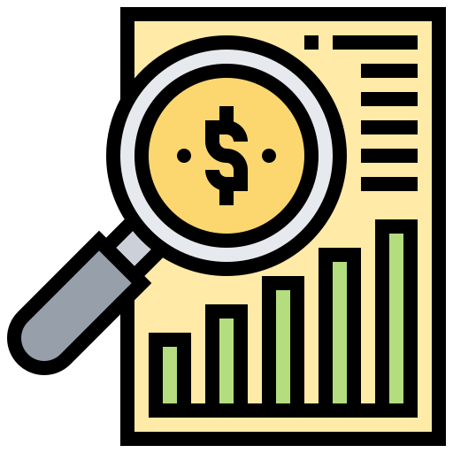
Expense Analysis
Definition

Slide 4
Expense Analysis
Process of analyzing all expenses incurred by a business to identify where and how money can be saved
It can be used by businesses of all sizes to help identify areas where they can reduce expenses and increase profits
Example:
Clothing store determined that it was spending too much money on advertising
They tracked the cost of advertising over time, and identified which ads generate the most revenue
They kept those ads, while removing the ones that didn't perform well

Slide 5
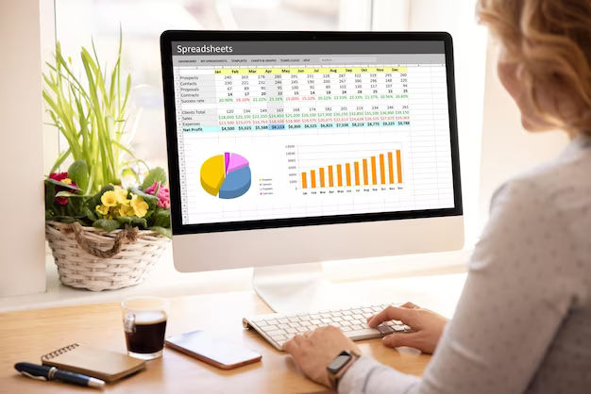
Benefits of Expense Analysis

Slide 6
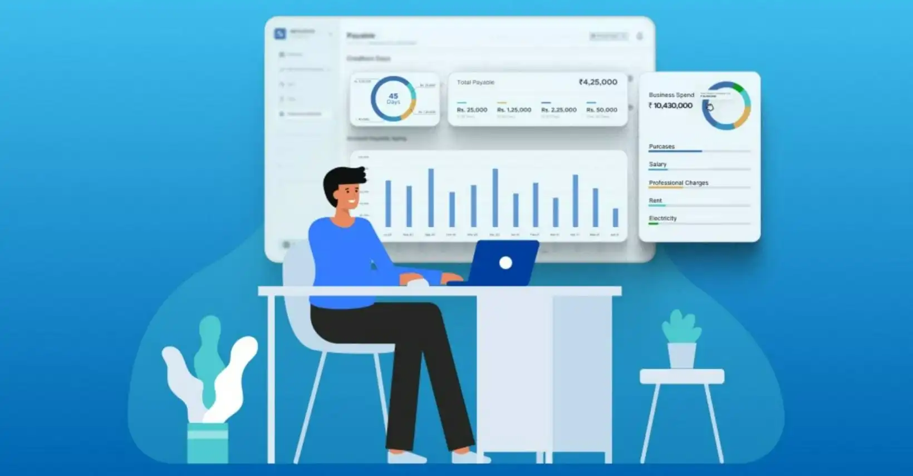
Importance of Expense Analysis
Important tool for businesses to help them manage their finances, improve their performance, and achieve long-term success
By understanding where and how expenses are being incurred, businesses can optimize resources and reduce costs
In addition, expense analysis can help identify opportunities for cost savings and improved efficiency

Slide 7
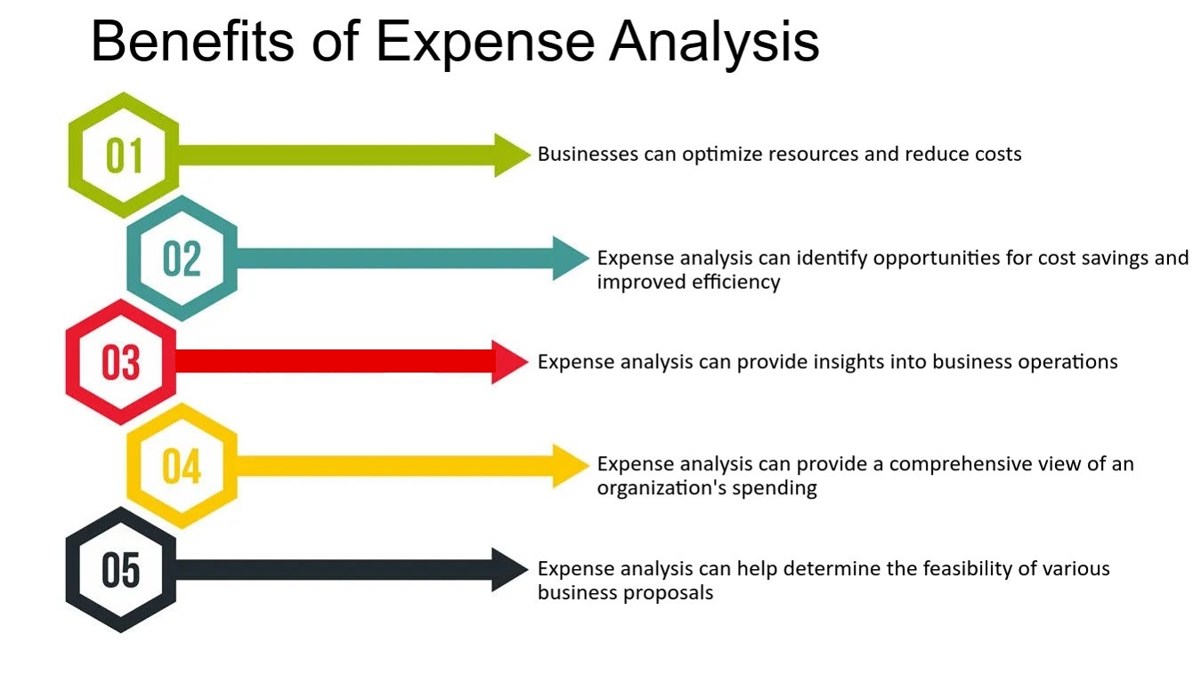
Benefits of Expense Analysis

Slide 8
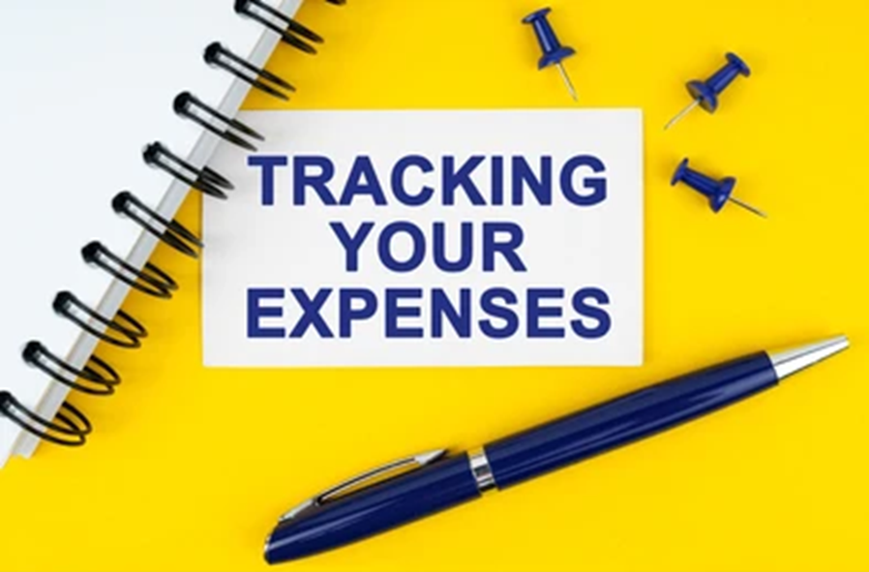
Types of Expenses to Track

Slide 9
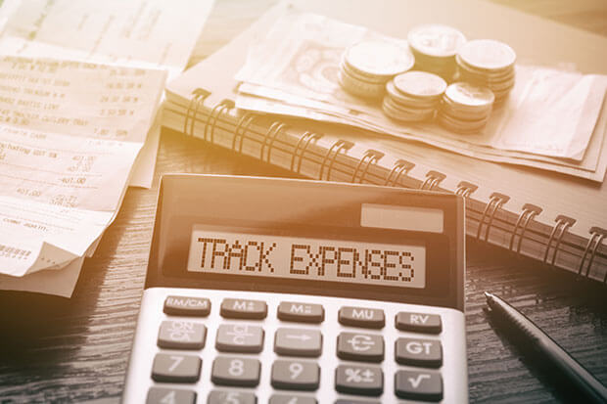
Types of Expenses to Track (1)
It's important to be aware of the different types of expenses you may incur so you can track them appropriately
Common types of expenses to keep an eye on:
Startup Costs
When starting a new business, there are a number of one-time costs you'll need to pay, such as legal fees, business licenses, and incorporation fees
Make sure to track these expenses so you can properly budget for them

Slide 10
Types of Expenses to Track (2)
Cost of goods sold (COGS)
This includes the direct costs associated with producing the products or services sold by the business
COGS includes materials, labor, and overhead costs
Operating Expenses
Ongoing costs of running your business, such as rent, utilities, payroll, and inventory
These expenses can fluctuate from month to month
It's important to track them carefully to ensure you're not overspending

Slide 11

Types of Expenses to Track (3)
Administrative expenses
The company has to pay for rent, travel, and other expenses such as insurance
These are usually recurring costs that are necessary for the company to sustain operations
One-time expenses
Some costs that the company incurs are not recurrent and may be paid only once
This may be a membership fee, license fee, etc.

Slide 12
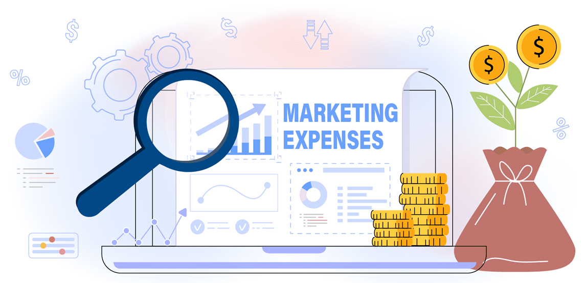
Types of Expenses to Track (4)
Marketing Expenses
Marketing is essential for any business, but it can be costly
These are expenses related to promoting the business, such as advertising and social media marketing
Be sure to track how much you're spending on each campaign or initiative, and analyze the results to see if it's worth the investment

Slide 13
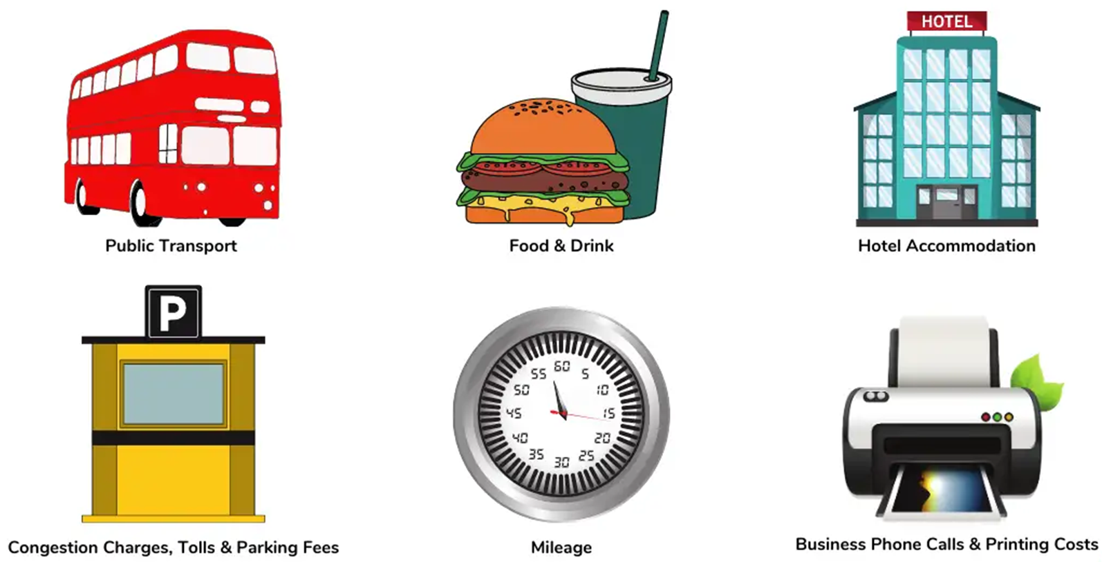
Types of Expenses to Track (5)
Travel Expenses
If you travel for business, you'll need to track your travel expenses, such as airfare, hotels, rental cars, etc.
Keep receipts and mileage logs so you can accurately report your expenses when tax time comes

Slide 14
Types of Expenses to Track (6)
Office expenses
If you have a physical office, there are a number of expenses that come with it, from rent to utilities to furniture
Examples: Office supplies, Cleaning Services, Coffee and Snacks
Be sure to track all of these expenses so you have a clear picture of your overhead costs
IT expenses
If you rely heavily on technology for your business, you may have significant IT expenses, from hardware to software to support

Slide 15
Types of Expenses to Track (7)
Employee expenses
There are a number of associated expenses, from salaries to benefits to training
Depreciation
This is a non-cash expense that reflects the decline in value of a business's assets over time

Slide 16
Types of Expenses to Track (8)
Interest expenses
This includes the interest paid on loans and other debts
Taxes
This includes national and local taxes owed by the business
Insurance expenses
This includes the cost of insuring the business against various risks, such as property damage and liability

Slide 17

Benefits of Tracking Your Expenses

Slide 18
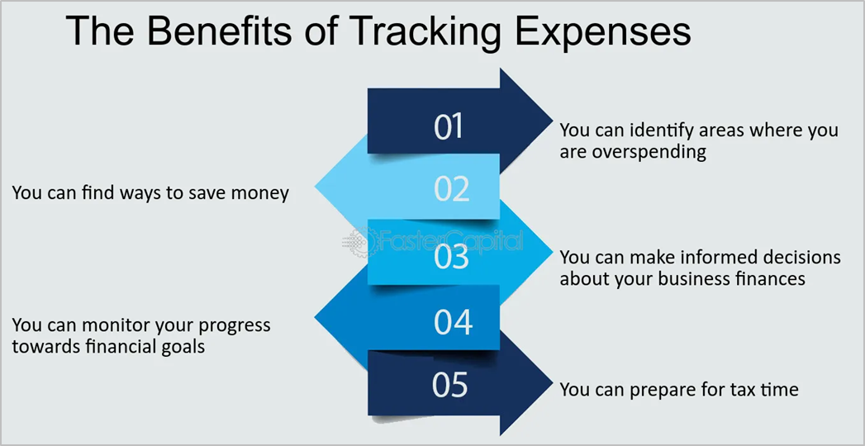
Benefits of Tracking Your Expenses
Tracking expenses helps business owners and managers make informed decisions about how to allocate resources and increase profitability
It's important to track expenses on a regular basis to ensure that the business is on track to meet its financial goals

Slide 19
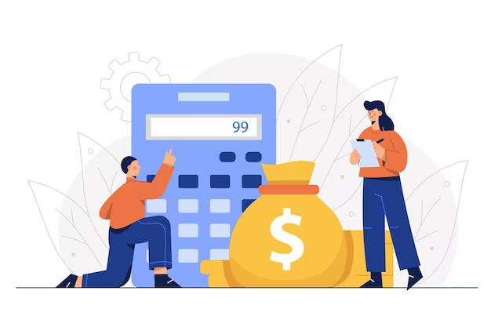
Types of Expense Analysis

Slide 20
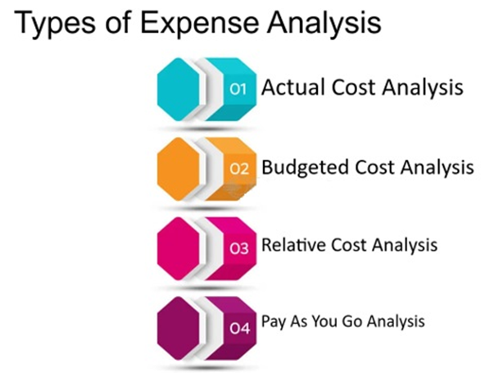
Types of Expense Analysis (1)
There are a variety of ways to analyze expenses and determine where the money is being spent
Below are four types of expense analysis:
Actual cost analysis
This is the most basic type of analysis
You simply track actual expenses and determine whether they match the budgeted amounts
This is the most accurate way to measure your spending, but it can be time-consuming

Slide 21
Types of Expense Analysis (2)
Budgeted cost analysis
This type of analysis uses predefined budget lines to track where your money is going
You then adjust the budget as necessary to reflect actual expenses
This method is easier to use, but it may not be as accurate
Relative cost analysis
This type of analysis compares expenses against each other to see which are higher or lower than expected
This can help you identify where you may be overspending or under-spending

Slide 22
Types of Expense Analysis (4)
Pay As You Go Analysis
Process of examining and evaluating the costs of expenses that are paid on a per-use basis
Method of analyzing and managing costs when they occur, rather than being pre-planned
These expenses are typically for services or products that are used only for a short period of time, such as cloud storage, software subscriptions, and utilities
By analyzing them, businesses can identify areas where they can save money by reducing usage or switching to a more cost-effective pricing model
This can help you stay within your budget, but it can be time-consuming

Slide 23
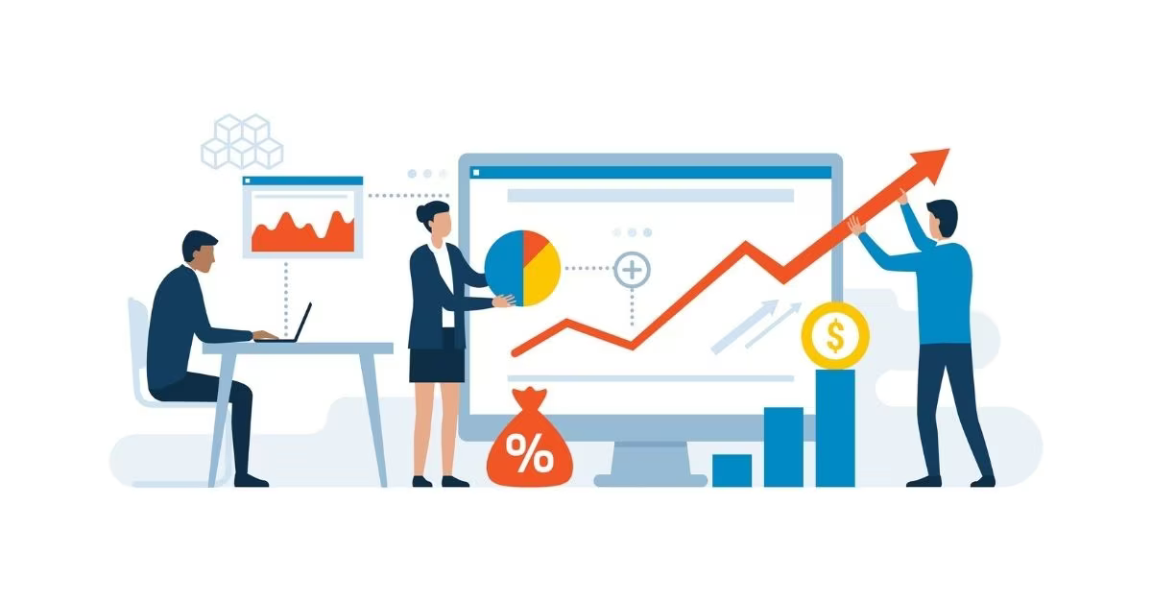
Analyze Your Business Expenses Step-by-Step

Slide 24
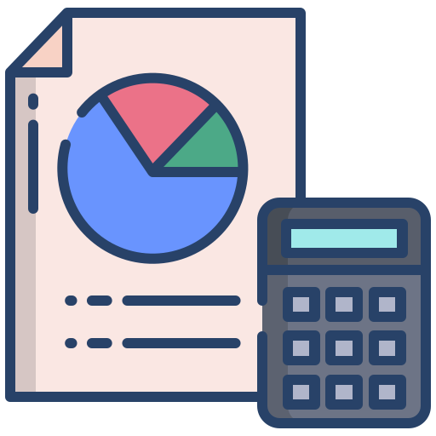
Analyze Your Business Expenses Step-by-Step (1)
Identify expenses
Start by gathering data on all of the expenses incurred by the business
Including fixed expenses (rent, salaries, etc.) and variable expenses (raw materials, marketing costs, etc.)
Categorize expenses
Organize the expenses into meaningful categories, such as cost of goods sold, administrative expenses, and marketing expenses

Slide 25
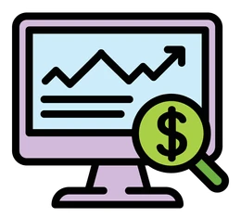
Analyze Your Business Expenses Step-by-Step (2)
Determine cost drivers
Identify the underlying factors that drive each expense category, such as the number of units sold or the amount of marketing spending
Calculate ratios
Use ratios such as gross profit margin and operating profit margin to evaluate the company's financial performance
Identify areas for improvement
Benchmark against competitors
Compare the company's expenses and ratios to those of similar businesses in the same industry to see how it stacks up

Slide 26

Analyze Your Business Expenses Step-by-Step (3)
Identify areas for cost reduction
Look for areas where expenses can be reduced without negatively impacting the business's ability to operate effectively
Example: Negotiating better deals with suppliers or finding more cost-effective marketing methods
Monitor and adjust
Continuously monitor expenses and adjust the analysis as necessary to ensure that the business is on track to achieve its financial goals

Slide 27

Analyze Your Business Expenses Step-by-Step (4)
Regular expense analysis can help businesses remain competitive and maximize profitability
The cost of goods sold is usually an expense that cannot be controlled
The rest of the expenses must be managed for the best results
Fixed expenses have the most significant impact when reduced
Example: Moving to smaller premises may lower the rent and make a big difference to the company's expenses and performance

Slide 28
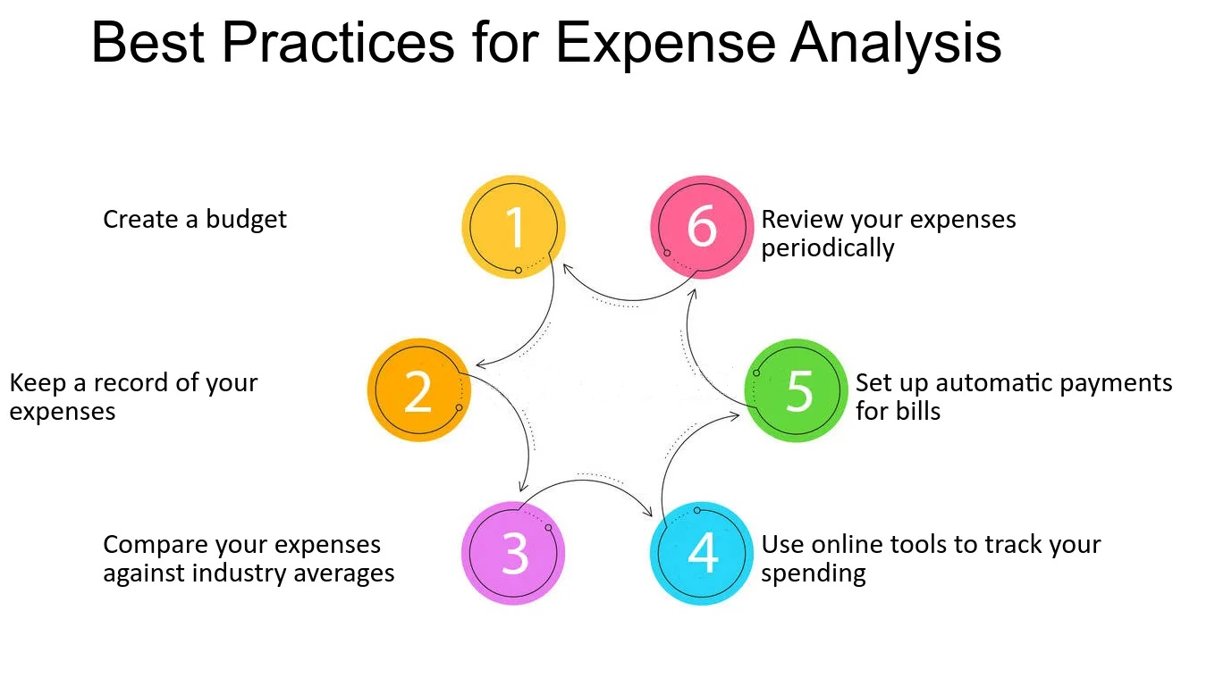
Best Practices for Expense Analysis

Slide 29
What Did We Learn Today?
…
…
…
Expense Analysis = Process of analyzing all expenses incurred by a business to identify where and how money can be saved
Benefits of Expense Analysis = Optimize resources and reduce costs, improve performance, achieve long-term success
Types of Expenses to Track = COGS, operating, administrative, one-time, marketing, travel, employee, IT, etc.
Benefits of Tracking Your Expenses = Help you to make informed decisions about where to allocate your resources and how to cut costs when necessary
Types of Expense Analysis = Actual cost analysis, Budgeted cost analysis, Relative cost analysis, Pay As You Go Analysis

Slide 30
Questions?

Slide 31

License
This course (slides, examples, code, demos, exercises, tutorials, homework, projects, documents, videos and other assets) is copyrighted content, created by SoftUni
Unauthorized copy, reproduction or use is illegal
© SoftUni – https://softuni.org
© Software University – https://softuni.bg

